Slide 1


Mobile Application Development Laboratory
Title of the Mini Project
220701229
ROSHINI V S
Mr. Bhuvaneswaran B, M.E.
Assistant Professor, Department of Computer Science and Engineering

Slide 2
Abstract
This project introduces a mobile-based Note Sharing App that enables students to upload, browse, and download academic notes categorized by semester, subject, and year. Built with Kotlin and Firebase, the app ensures secure authentication, real-time data access, and offline availability of downloaded content. The system promotes collaborative learning and provides an organized platform for educational resource sharing. Future work includes content validation and personalized recommendations.

Slide 3
Need for the Proposed System
The proposed system is a Kotlin-based mobile app that allows students to securely sign in, upload, and download academic notes categorized by year, semester, and subject. It uses Firebase Authentication for login, Cloud Storage for file handling, and Firestore for metadata. A simple Jetpack Compose UI enables easy navigation, and a profile page lets users track their activity. This centralized platform promotes organized and collaborative note sharing.

Slide 4
Advantages of the Proposed System
The proposed system offers a centralized and organized platform where students can easily upload and access study materials based on academic year, semester, and subject. With a simple and user-friendly interface, it minimizes effort in searching for notes. The use of Firebase Authentication ensures secure user access, while cloud storage allows easy and reliable access to uploaded content anytime. This system also promotes collaborative learning by encouraging students to share resources with peers.

Slide 5
Literature Survey
Paper | Advantages | Disadvantages
[1] Smith & Jones (2019) | Encourages collaboration Easy access to notes Promotes eco-friendly learning | Needs internet Quality of notes not guaranteed Possible privacy issues
[2] M. Lee (2020) | Smart search & tags Personalized suggestions Cloud backup | Bias in recommendations. Not user-friendly for all Poor LMS integration

Slide 6
Main Objective
The main objective of this system is to develop a simple, user-friendly mobile application that enables students to upload, share, and access academic notes based on year, semester, and subject. The app aims to support collaborative learning by providing an organized platform where students can easily find and contribute study materials.

Slide 7
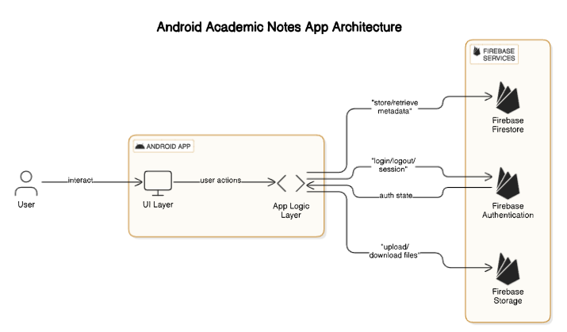
Architecture

Slide 8
System Requirements
Hardware Requirements:
Device: Android smartphone
or tablet
Processor: 1.5 GHz or higher
RAM: 2 GB or more
Storage: 100 MB free space (for app and notes)
Display: 720p or higher resolution
Software Requirements:
OS: Android 5.0 or higher
Development: Android Studio, Kotlin
Libraries: RecyclerView, Room Database, Glide/Picasso
Version Control: Git

Slide 9
Functional Description
Module 1: User Interface (UI) & Note Upload
Short Description:
This module focuses on the main interface of the app, where users can navigate through different categories (year, semester, subject) to upload and share notes. It allows users to select files, view their uploaded notes, and browse available notes by other users.
DFD / Activity Diagram:
The module includes a flow from the home screen, where users can select categories, to uploading files. Once the notes are uploaded, the app will store them locally and display them in the appropriate section.

Slide 10
Functional Description
Module 2: Note Viewing and Downloading
Short Description:
This module allows users to browse, view, and download notes shared by others. It categorizes notes by subject, semester, and year. The app provides an easy-to-use interface to view content, with the option to download for offline use.
DFD / Activity Diagram:
Users can view the list of available notes based on filters, download them for offline use, and access the file through the app's interface. This is supported by the local storage where notes are saved.

Slide 11
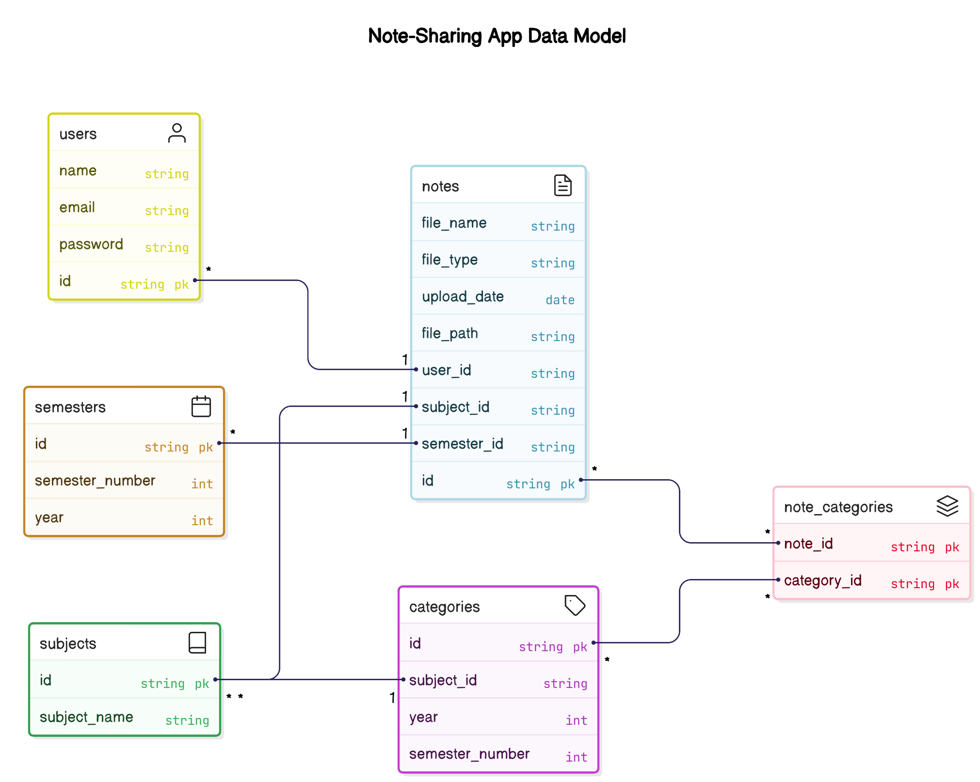
Table Design

Slide 12
Process Design
Main Process: Note Sharing System
Description:
Manages user interactions like uploading, viewing, and downloading notes with categories like subject and semester.
Steps:
Upload Notes - User uploads and categorizes notes.
View Notes - User browses and views notes.
Download Notes - User downloads selected notes.

Slide 13
Process Design
Sub Process 1: Note Upload
Description: Handles file upload
and categorization.
Steps:
Select File
Assign Metadata
Store
Sub Process 2: Note Viewing
Description: Browsing and viewing notes.
Steps:
Filter Notes
Display Notes
View Selected Note
Sub Process 3: Note Download
Description: Handles note download for offline use.
Steps:
Select Note
Store Locally
Confirm Download

Slide 14
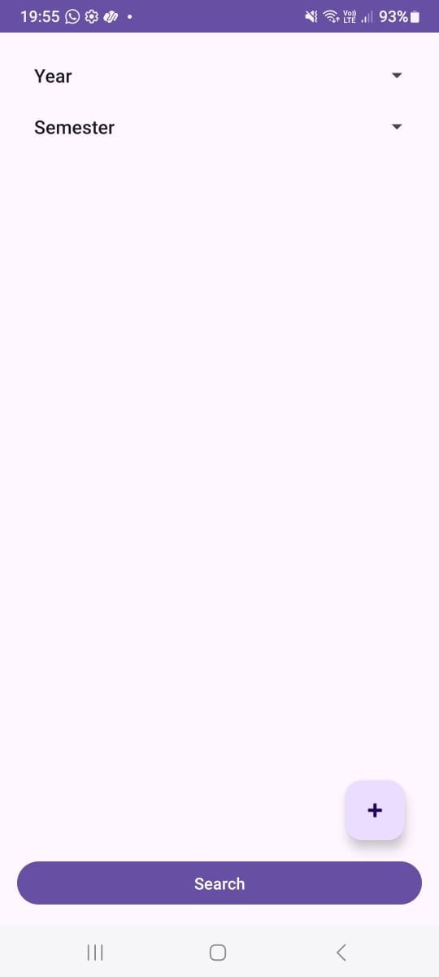
Implementation
Implementation of Module 1: Note Viewing
This module lets users browse and view notes filtered by subject, year, and semester. A search feature helps find specific notes, displaying details like title, description, and subject.

Slide 15
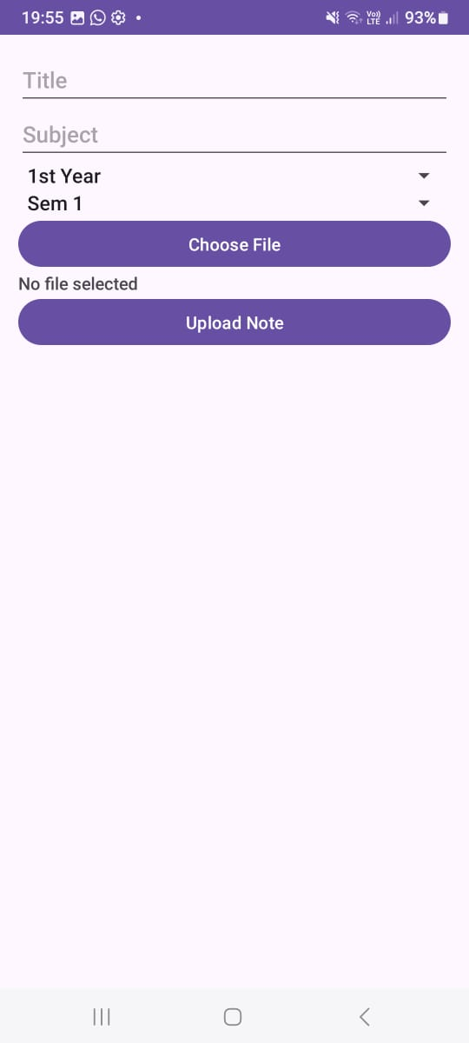
Implementation
Implementation of Module 2: Note Upload
Users can upload notes by selecting files and adding metadata like subject and semester. The uploaded notes are stored for future access.

Slide 16
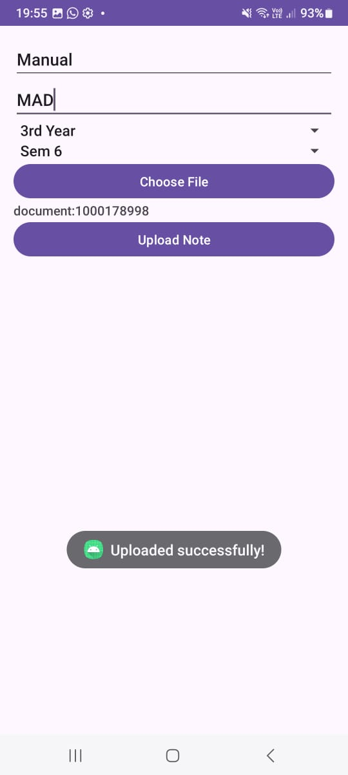
Testing
Testing verifies users can upload notes with correct metadata. It also checks that notes are categorized correctly and errors are handled, especially for unsupported formats.

Slide 17
Conclusions
The Note Sharing App successfully facilitates easy sharing and accessing of study materials. With a user-friendly interface for searching, filtering, and uploading notes, it enhances collaborative learning. Testing ensures the app's functionality is reliable, with smooth performance for both viewing and uploading notes. By providing an efficient platform for students, the app promotes knowledge sharing and streamlines study material management. However, future improvements could include adding authentication and cloud storage features to enhance data security and accessibility.

Slide 18
Future Enhancement
To enhance security and personalization, implementing user authentication would allow students to create accounts, manage their notes, and track uploads. Cloud storage integration would ensure that notes are safely stored and accessible across multiple devices, providing users with seamless access to their content anytime, anywhere.
Introducing real-time collaboration features, such as shared notes or group discussions, could foster better interaction between users. This would enable students to collaborate on notes, add comments, and share resources in real-time, enhancing the learning experience and promoting collective knowledge sharing.

Slide 19
IEEE Paper
Title: Extending and Evaluating a Collaborative Note-Taking Application: A Pilot Study
Authors: E. Popescu, S. Ilie, and C. Stefan
Title: A System Perspective to Establish a Mobile Collaborative Learning Environment
Authors: Y. Zhang, X. Li, J. Liu, and Y. Zhang

Slide 20
References
[1] E. Popescu, S. Ilie, and C. Stefan, "Extending and Evaluating a Collaborative Note-Taking Application: A Pilot Study," IEEE Transactions on Learning Technologies, vol. 14, no. 1, pp. 54–63, Jan.–Mar. 2021, doi: 10.1109/TLT.2020.2992689.
[2] Y. Zhang, X. Li, J. Liu, and Y. Zhang, "A System Perspective to Establish a Mobile Collaborative Learning Environment," IEEE Access, vol. 8, pp. 115305–115316, 2020, doi: 10.1109/ACCESS.2020.3003683.

Slide 21
Thank You…!

